Slide 1

Digital Humanities
CS452 – Senior Software Engineering Capstone Project
Fall 2015-16

Slide 2
The Goals of the Project
Determining the sequential order of digital files.
Use Levenshtein’s Distance algorithm to determine the order.
Pick three different algorithms to compare to Levenstein’s Distance
Compare results
Compare time management
Write a publishable research paper on comparisons

Slide 3
Challenge to the Team:
Research
Research Levenshtein’s Distance algorithm
Research three alternative algorithms for comparison
Code Levenshtein’s Distance algorithm
Coding
Each member codes the alternative algorithms picked
Tests were run to compare
Do comparisons
Each member ran the program on individual computers
Each member recorded results
Results and Writing
Results were compared using Microsoft Excel charts
Each member wrote about their individual algorithms
Rough Draft and final draft was submitted to Ms. Mayfield for approval

Slide 4
Needleman-Wunsch Algorithm
Grid Based String Comparison
The algorithm assigns ASCII values to each string
Loops through the grid comparing adjoining grids
Assigns separate values for string values that match and mismatch
If algorithm recognizing gap in sequence – gap penalty is assigned
This assigns data to the grid
Then through recursion the alignment is traced back through grid
Resulting max separation value in the lower right corner of the grid

Slide 5
Time Complexity for Needleman-Wunsch
Using the Emily Dickinson Poem

Slide 6
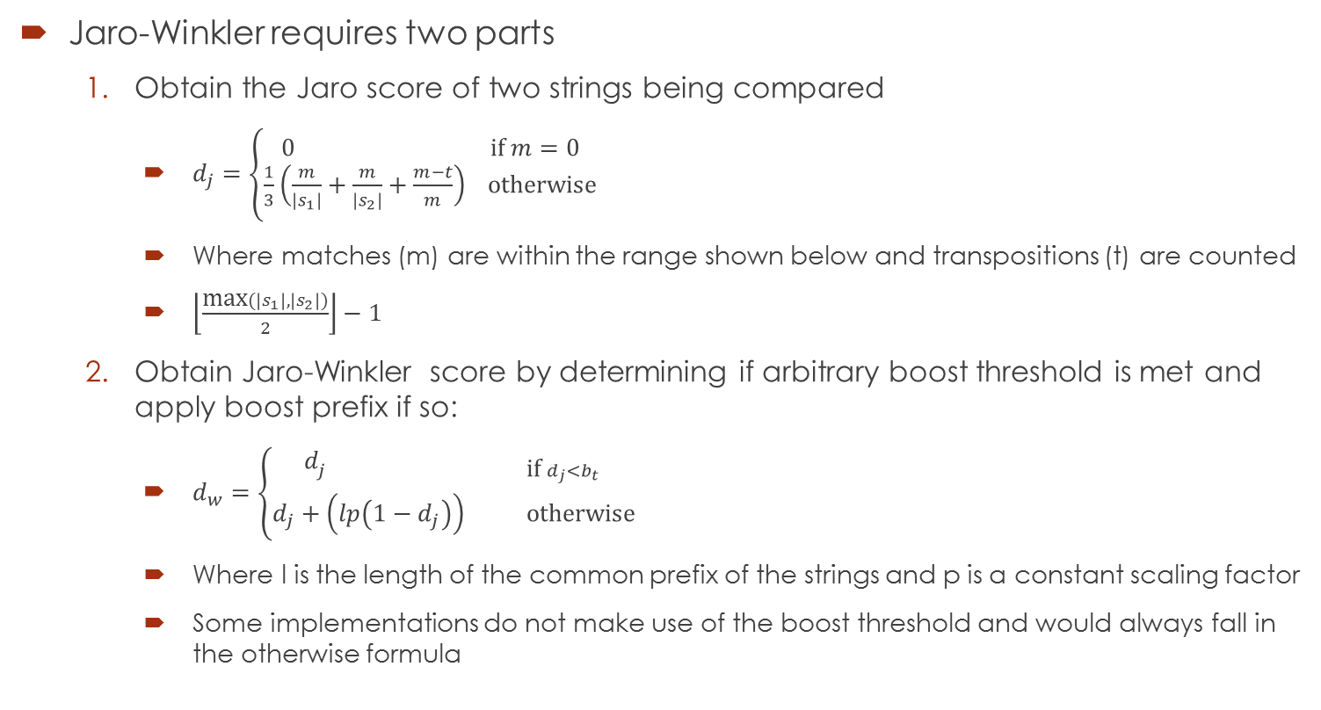
Jaro-Winkler Algorithm
Jaro-Winkler requires two parts
Obtain the Jaro score of two strings being compared
$d_{j}=\left\{\begin{aligned}0 \text{if} m=0 \\ \frac{1}{3}\left(\frac{m}{\left|s_{1}\right|}+\frac{m}{\left|s_{2}\right|}+\frac{m−t}{m}\right) \text{otherwise}\end{aligned}\right.$
Where matches (m) are within the range shown below and transpositions (t) are counted
$\left\lfloor \frac{\text{max}(\left|s_{1}\right|, \left|s_{2}\right|)}{2}\right\rfloor −1$
Obtain Jaro-Winkler score by determining if arbitrary boost threshold is met and apply boost prefix if so:
$d_{w}=\left\{\begin{aligned}d_{j \text{if} d_{j}<b_{t} } \\ d_{j}+\left(lp\left(1−d_{j}\right)\right) \text{otherwise}\end{aligned}\right.$
Where l is the length of the common prefix of the strings and p is a constant scaling factor
Some implementations do not make use of the boost threshold and would always fall in the otherwise formula

Slide 7
Time Complexity for Jaro-Winkler
Using the Emily Dickinson Poem

Slide 8
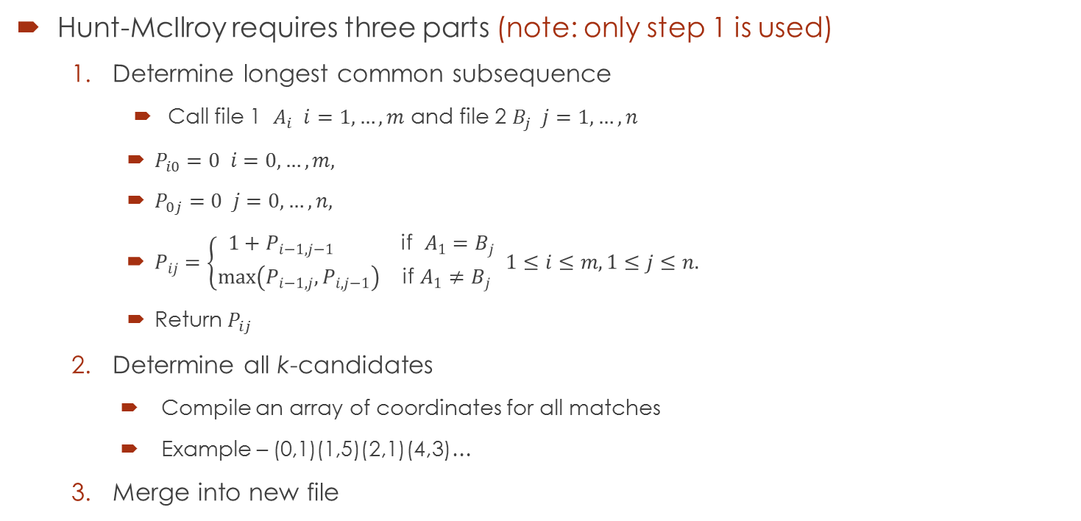
Hunt-McIlroy Algorithm
Hunt-McIlroy requires three parts (note: only step 1 is used)
Determine longest common subsequence
Call file 1 $A_{i} i=1,…,m$ and file 2 $B_{j} j=1,…,n$
$P_{i0}=0 i=0, …, m,$
$P_{0j}=0 j=0,…,n,$
$P_{ij}=\left\{\begin{aligned}1+P_{i−1,j−1} \text{if} A_{1}=B_{j} \\ \max\left(P_{i−1,j},P_{i,j−1}\right) \text{if} A_{1}≠B_{j} \end{aligned}1≤i≤m, 1≤j≤n.\right.$
Return $P_{ij}$
Determine all k-candidates
Compile an array of coordinates for all matches
Example – (0,1)(1,5)(2,1)(4,3)…
Merge into new file

Slide 9
Time Complexity for Hunt-McIlroy
Using the Emily Dickinson Poem

Slide 10
Final Results - Analysis

Slide 11
Conclusions
Levenshtein’s Distance method may still be the optimal choice for comparing larger data such as manuscript drafts.
We have not found evidence to support any claims that the ordering assumed by our raw results could be of value.
The Needleman-Wunsch results proved to be the closest match to Levenshtein’s, and at times provided a better distance value, but did not perform better overall.
Of all the algorithms we tested, only the Hunt-McIlroy method was intended to be used with large inputs, and though it was designed for comparing larger files line by line, it was intended to solve a different kind of problem.

Slide 12
To Continue
We would recommend that further research should be done in regard to other more time-efficient algorithms, and the selection of larger input data.
Algorithms that are easily parallelizable would be preferable.
Algorithms developed in more recent years, such as Minkowski Distance or trigrams would likely return results in less time and be better equipped to handle larger data sets.

Slide 13
Thank you for your time!
William ‘Greg’ Dawkins, Kevin Woods, Marlene

